Slide 1
CUSTOMER CHURN PREDICTION MODEL
BRIAN MUTHAMA

Slide 2
PROJECT INTRODUCTION:
SyriaTel, a telecom company, is leveraging predictive analytics to combat customer churn. By analyzing historical data encompassing demographics, usage patterns, and service interactions, a binary classifier model is developed. This model enables real-time prediction of churn likelihood, empowering SyriaTel to implement personalized retention strategies for at-risk customers. Through this approach, SyriaTel aims to optimize marketing efforts, enhance customer retention, and ultimately boost profitability.

Slide 3
Business Understanding:
SyriaTel, a telecom company, targets customer churn through predictive analytics.
Historical data on demographics, usage patterns, and service interactions is utilized.
A binary classifier model is developed to predict churn likelihood in real-time.
SyriaTel employs personalized retention strategies for at-risk customers.
The approach optimizes marketing efforts, enhances customer retention, and boosts profitability.

Slide 4
Data Understanding:
SyriaTel gathers historical customer information to predict churn.
This data includes details like customer demographics, usage patterns, subscriptions, and service interactions.
Before training models, the data is carefully examined, identifying important features and dealing with missing values and categorical variables.
Models are trained using this processed data to predict churn, and their performance is evaluated based on accuracy and F1 score metrics.
To improve accuracy, the models' parameters are adjusted through optimization.
This process helps SyriaTel understand why customers leave and implement strategies to keep them, ultimately reducing churn.

Slide 5
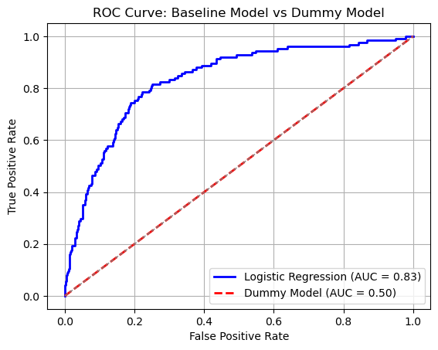
DATA ANALYSIS:
Logistics regression Model:
Below are the findings through out the project. The ROC curve and AUC of the first model built(logistics regression baseline) vs dummy model. The bigger the AUC the better the model and the higher the F1 score the better the model:
Baseline accuracy = 86%
Baseline precision = 87%
Baseline recall = 97%
Baseline f1score = 92%

Slide 6
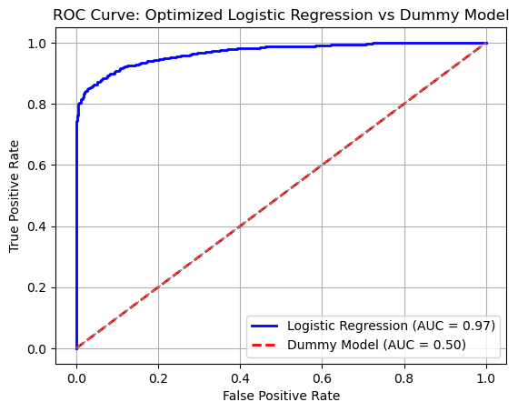
Below is the ROC curve and precision,accuracy,F1 and recall scores of the baseline model after doing hyperparameter tuning, feature selection and dealing with class imbalances in the data.
As seen the AUC is 97% which is higher than the initial baseline model and the F1 score for this model improved to 91%.

Slide 7
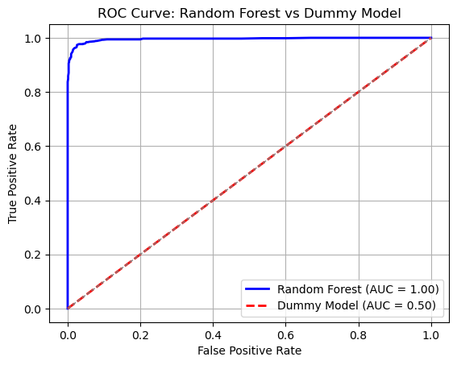
Random Forests Model:
Trying out a new complex model with the Random Forests Classifier and these are the baseline values for the AUC and F1 Scores after grid search.
Right off the bat the AUC of this model is 100%; much higher than the logistics regression model, even though this could suggest overfitting.
The F1 score were 97% a higher value than the logistics regression model and so this is clearly a better model from the baseline compared to logistics regression

Slide 8
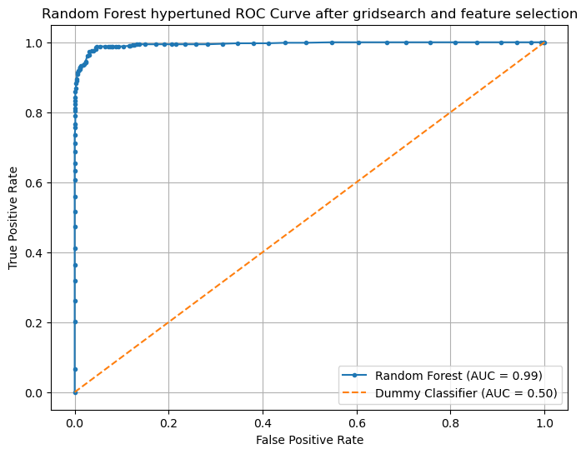
Optimization of random forest model:
Below are the ROC curve and AUC after optimization of the random forest model to be used as a final model. The F1 scores were 97% so was accuracy, recall and precision showing a balance in the performance of the model across various metrics. The Area under the curve(AUC) was 99% which is is good. The cross validation results indicate that this optimized model was more consistent and stable than the baseline random forest model.

Slide 9
Conclusions:
We analyzed four models to predict customer churn: basic logistics regression, optimized logistics regression, random forest, and optimized random forest. The top 10 features were:
account length
international plan
voice mail plan
number vmail messages
total day minutes
total day calls
total day charge
total eve minutes
total eve calls
total eve charge

Slide 10
Recommendations:
Based on our analysis, I recommend using the optimized random forest model to predict customer churn. It outperformed other models, providing valuable insights into customer behavior with features like account length and international plan status. Its accuracy and reliability make it a powerful tool for identifying potential churners, helping businesses improve customer retention strategies and satisfaction.

Slide 11
Summary:
In summary, the comprehensive evaluation of model performance metrics, feature selection, and discriminative ability unequivocally supports the selection of the optimized random forest model as the final choice for predicting customer churn. By deploying this model, SyriaTel can proactively address churn risk and implement targeted retention strategies, ultimately leading to improved customer satisfaction and loyalty.

Slide 12
THANK YOU
Project by: Brian Muthama
Date: 6/07/2024
Email: brian.muthama@student.moringaschool.com

